Slide 1

HS 2015
Current Trends in Distributed Systems
Final presentation
Group:
Patrick Zumsteg
Simon Wallny
Philipp Oldenburg

Slide 2
Structure
Idea
Overview
Sensor Server & Client
  Problems & Solutions
DBMan
Collecting & Providing Data
  Unnecessary Complexity?
Classification
Storm Topology
Lessons Learned
Web Visualization
Demo
HS 2015
Current Trends in Distributed Systems – Final presentation
<Nummer>

Slide 3
Idea
Weather station
  Log sensor data
    Label data points with a pre-existing weather service
  Train a classifier to tell current weather condition
  Visualize on a web page
  Stretch goal: predict weather
HS 2015
Current Trends in Distributed Systems – Final presentation
<Nummer>

Slide 4

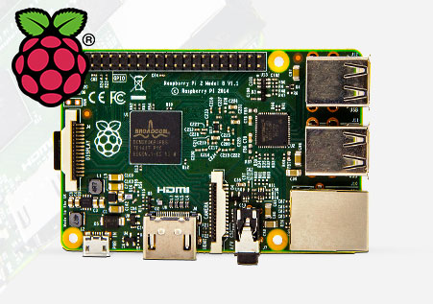

Overview
DBMan
Storm Cluster
Sensor Server
WebServer
HS 2015
Current Trends in Distributed Systems – Midterm presentation
<Nummer>

Slide 5

Sensor Server & Client
Running on Raspberry Pi 1
Uses simple socket communication
Using sensor library:
  https://github.com/adafruit/Adafruit_Python_BMP
Java Client
  Listener Thread
  Simple protocol
HS 2015
Current Trends in Distributed Systems – Midterm presentation
<Nummer>

Slide 6

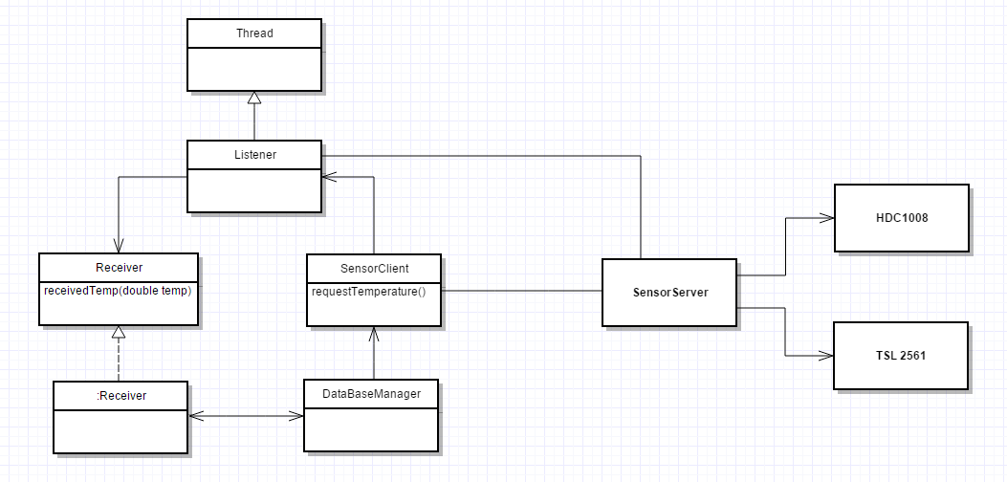
SensorServer & Client Communication
HS 2015
Current Trends in Distributed Systems – Midterm presentation
<Nummer>

Slide 7
Problems & Solutions
Wifi Connection problems
  Deploy SensorServer @ home
Communication problems
  Design a stable socket solution
Deploying Topologies in Apache Storm
  Distributed used libraries onto every node
HS 2015
Current Trends in Distributed Systems – Final presentation
<Nummer>

Slide 8
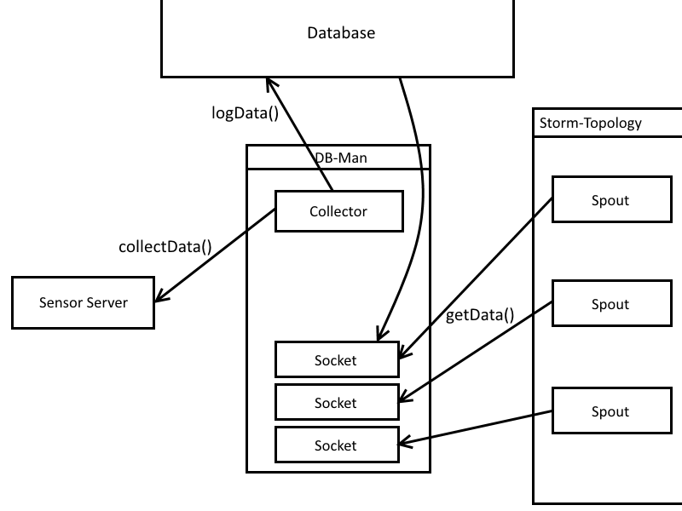
DBMan – Before
HS 2015
Current Trends in Distributed Systems – Final presentation
<Nummer>

Slide 9
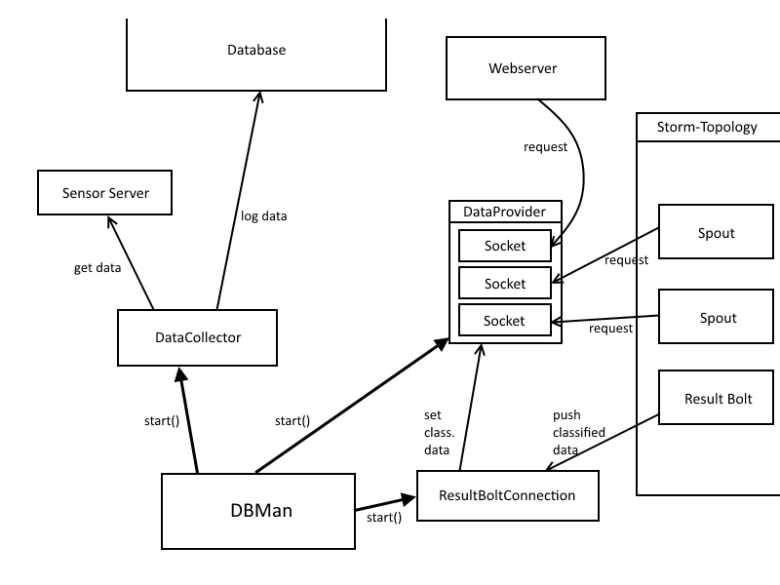
DBMan – After
HS 2015
Current Trends in Distributed Systems – Final presentation
<Nummer>

Slide 10
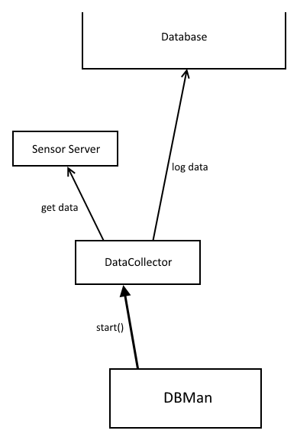
Collecting Data
Central module: DataCollector Thread
Periodically logs data
Independently receives new data
Missing data: default values
HS 2015
Current Trends in Distributed Systems – Final presentation
<Nummer>

Slide 11
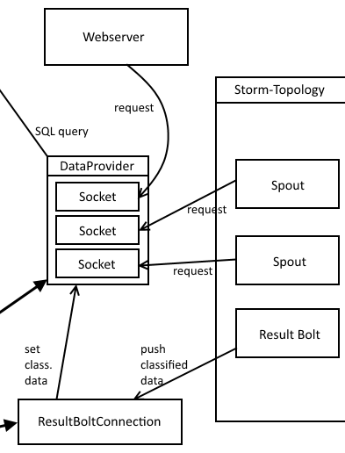
Providing Data
Central Module: DataProvider Thread
  Accepts connections
  Reads data from DB
  Returns JSON
Result Bolt sends classified data tuple
  Can be requested from DataProvider
HS 2015
Current Trends in Distributed Systems – Final presentation
<Nummer>

Slide 12
Unnecessary Complexity?
Lots of different modules – why not something easier?
  Resilience: no critical failures, modules easily restarted
  Communication via the internet → unexpected waiting times
    Avoiding blocking methods in important threads
  Reasonable distribution of areas of responsibility
    Easier to trace errors
HS 2015
Current Trends in Distributed Systems – Final presentation
<Nummer>

Slide 13
Classification (Mid-Term)
Naive Bayes
SVM
4-dimensional feature space
  Temperature
  Wind speed
  Air pressure
  Humidity
HS 2015
Current Trends in Distributed Systems – Final presentation
<Nummer>

Slide 14
Classification (Final)
Bayes Classifier
8-dimensional feature space
  Temperature
  Wind speed
  Air pressure
  Humidity
  Δ Temperature
  Δ Wind speed
  Δ Air pressure
  Δ Humidity
HS 2015
Current Trends in Distributed Systems – Final presentation
<Nummer>

Slide 15


Classification
Training in MatLab
Classifying in Java
JMatIO
HS 2015
Current Trends in Distributed Systems – Final presentation
<Nummer>

Slide 16
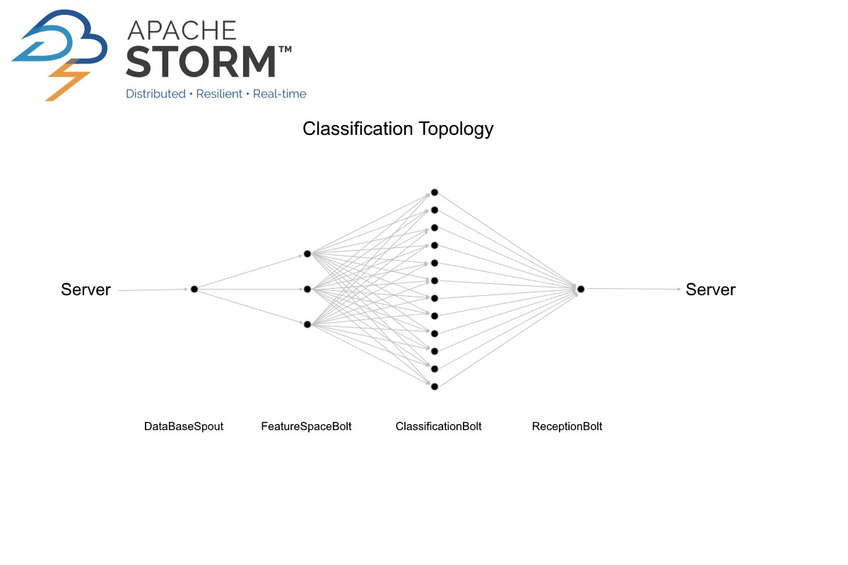
Storm Topology
HS 2015
Current Trends in Distributed Systems – Final presentation
<Nummer>

Slide 17
Problems, Challenges and Learned Lessons
OpenWeatherMap
  Overall positive impression
  But not without drawbacks:
    Classification sometimes questionable
    Strange anomalies in provided data
Think before you code
  Don't just keep fixing the latest error,
  focus on the big picture
To properly train a weather classifier,
have at least one year's worth of data.
HS 2015
Current Trends in Distributed Systems – Final presentation
<Nummer>

Slide 18
Web Visualization
Apache Web Server
  PHP Skripts
HTML/CSS side
  Communicating via JQuery with webserver
Graph Library: CanvasJS
HS 2015
Current Trends in Distributed Systems – Final presentation
<Nummer>

Slide 19
HS 2015
Current Trends in Distributed Systems
Final presentation
Group:
Patrick Zumsteg
Simon Wallny
Philipp Oldenburg

